Slide 1


Data Science
Predict the sales of a store
By understanding the customers and making customer-centric business more effective.
Sonam De
CS 527 Fall 2019
Final Project

Slide 2
Introduction
Analysis - better understand the customers and conduct customer-centric marketing
Proposed Model - On the basis of the Recency, Frequency, and Monetary model, customers have been segmented into various meaningful groups using the k-means clustering algorithm and tried to identify the main characteristics of the consumers in each segment.

Slide 3
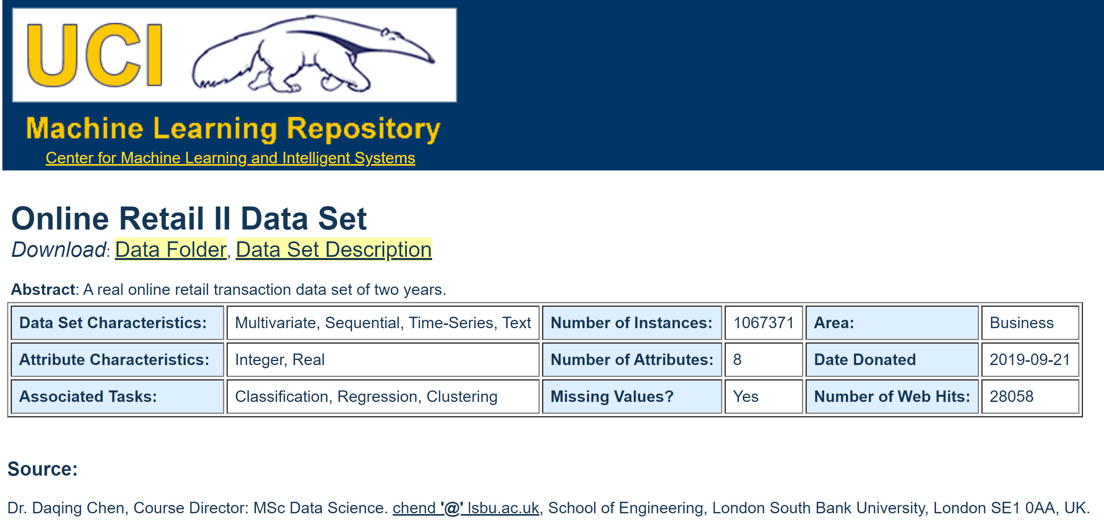
Dataset source
https://archive.ics.uci.edu/ml/datasets/Online+Retail+II
It has 151911 rows of 8 variables

Slide 4
Data reviewing steps
Data Exploration – looking at categorical and continuous feature summaries and making inferences about the data.
Data Cleaning – imputing missing values in the data and checking for outliers
Feature Engineering – modifying existing variables and creating new ones for analysis
Model Building – making predictive models on the data

Slide 5
Factors affects sales:
Which items/products’ on web pages has a customer visited? How long has a customer stayed with each web page, and in which sequence has a customer visited a set of products’ web pages?
Purchase pattern: What are customers’ purchase behavior patterns? Which products/items have customers purchased together often? In which sequence the products have been purchased?
Sales pattern: What are the sales patterns in terms of various perspectives such as products/items, regions and time (weekly, monthly, quarterly, yearly and seasonally), and so on?
Identifying customer: Who are the most/least valuable customers to the business? What are the distinct characteristics of them?
City type: Customers from urban cities may have higher sales because of the higher income levels of people.
Population Density: Densely populated areas can have higher sales because of more demand.

Slide 6
Product Level concerns:
Brand: Branded products may have higher sales because of higher trust in the customer.
Packaging: Products with good packaging can attract customers and sell more.
Utility: Daily use products may have a higher tendency to sell as compared to the specific use products.

Slide 7
DATA PRE-PROCESSING
Variables selection: Variables of interest from the given dataset have been chosen: Invoice, StockCode, Quantity, Price, InvoiceDate and PostCode.
Created a variable named Amount, by multiplying Quantity with Price, which gives the total amount of money spent per product/item in each transaction.
Separate the variable InvoiceDate into two variables Date and Time. This allows different transactions created by the same consumer on the same day but at different times to be treated separately.
Missing values: Filter out any transactions that do not have a postcode associated with. This resolves any missing value issues in relation to the variable PostCode.
Sorting: sort the dataset by Postcode and create three essential aggregated variables Recency, Frequency and Monetary.

Slide 8
RFM
Recency -how long it has been since a customer last placed an order with the company
Frequency-how often a customer orders from the company in a certain defined period
Monetary value- the amount that a customer spends on an average transaction

Slide 9
Computation of RFM
Sorting customer data based on RFM, grouping and analyzing results
Example: – Customer base: 400,000 customers – Sample size: 40,000 customers – Firm‟s marketing mailer campaign: $150 discount coupon – Response rate: 808 customers (2.02%)
Recency coding: Analysis –
Test group of 40,000 customers is sorted in a descending order based on the criterion of “most recent purchase date”.
The earliest purchasers are listed on the top and the oldest are listed at the bottom.
The sorted data is divided into five equal groups (20% in each group)
The top most group is assigned a recency code of 1 and the next group a code of 2 and so on, until the bottom most group is assigned a code of 5
Analysis of customer response data shows that the mailer campaign got the highest response from customers grouped in recency code 1 followed by code 2 etc

Slide 10
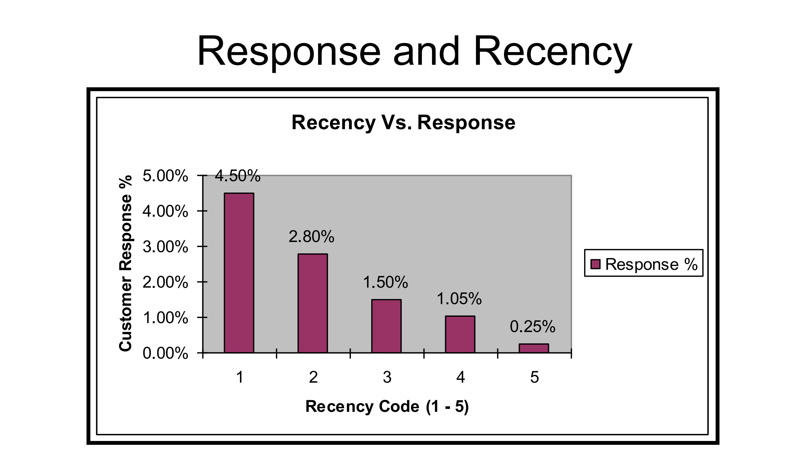
Graph shows the distribution of percentage of those customers who responded fell within the recency code grouping of 1 through 5. Highest response rate (4.5%) for the campaign was from customers in the test group who fell in the highest recency quintile (recency code =1)

Slide 11
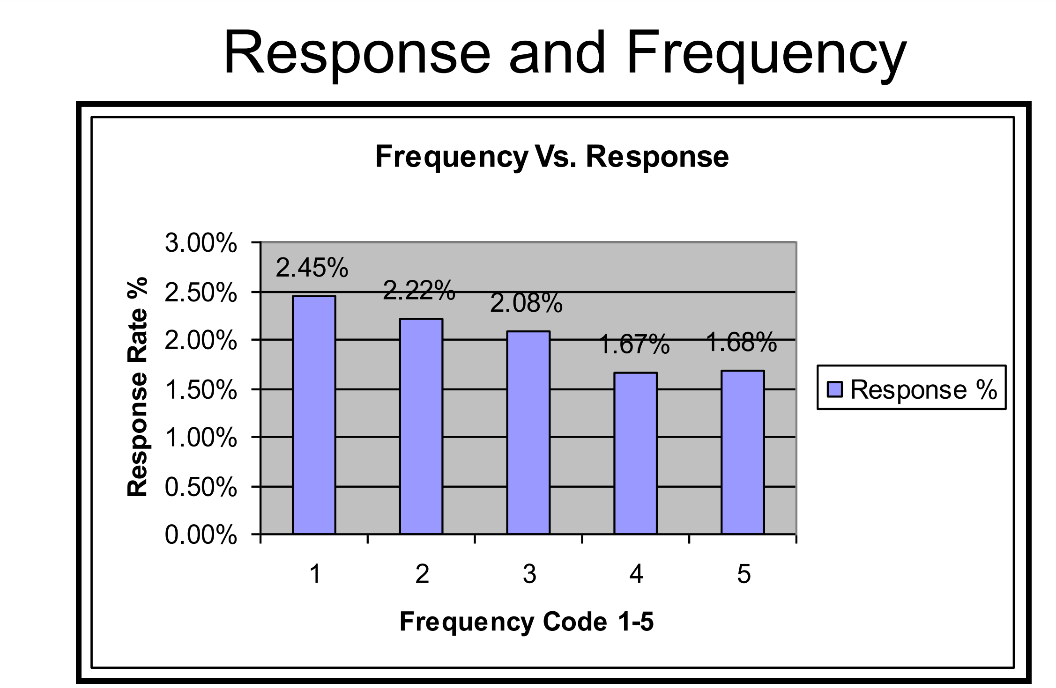
Graph shows the distribution of what % of those customers who responded fell within the frequency code grouping of 1 through 5 The highest response rate (2.45%) for the campaign was from customers in the test group who fell in the highest frequency quintile (frequency code =1)

Slide 12
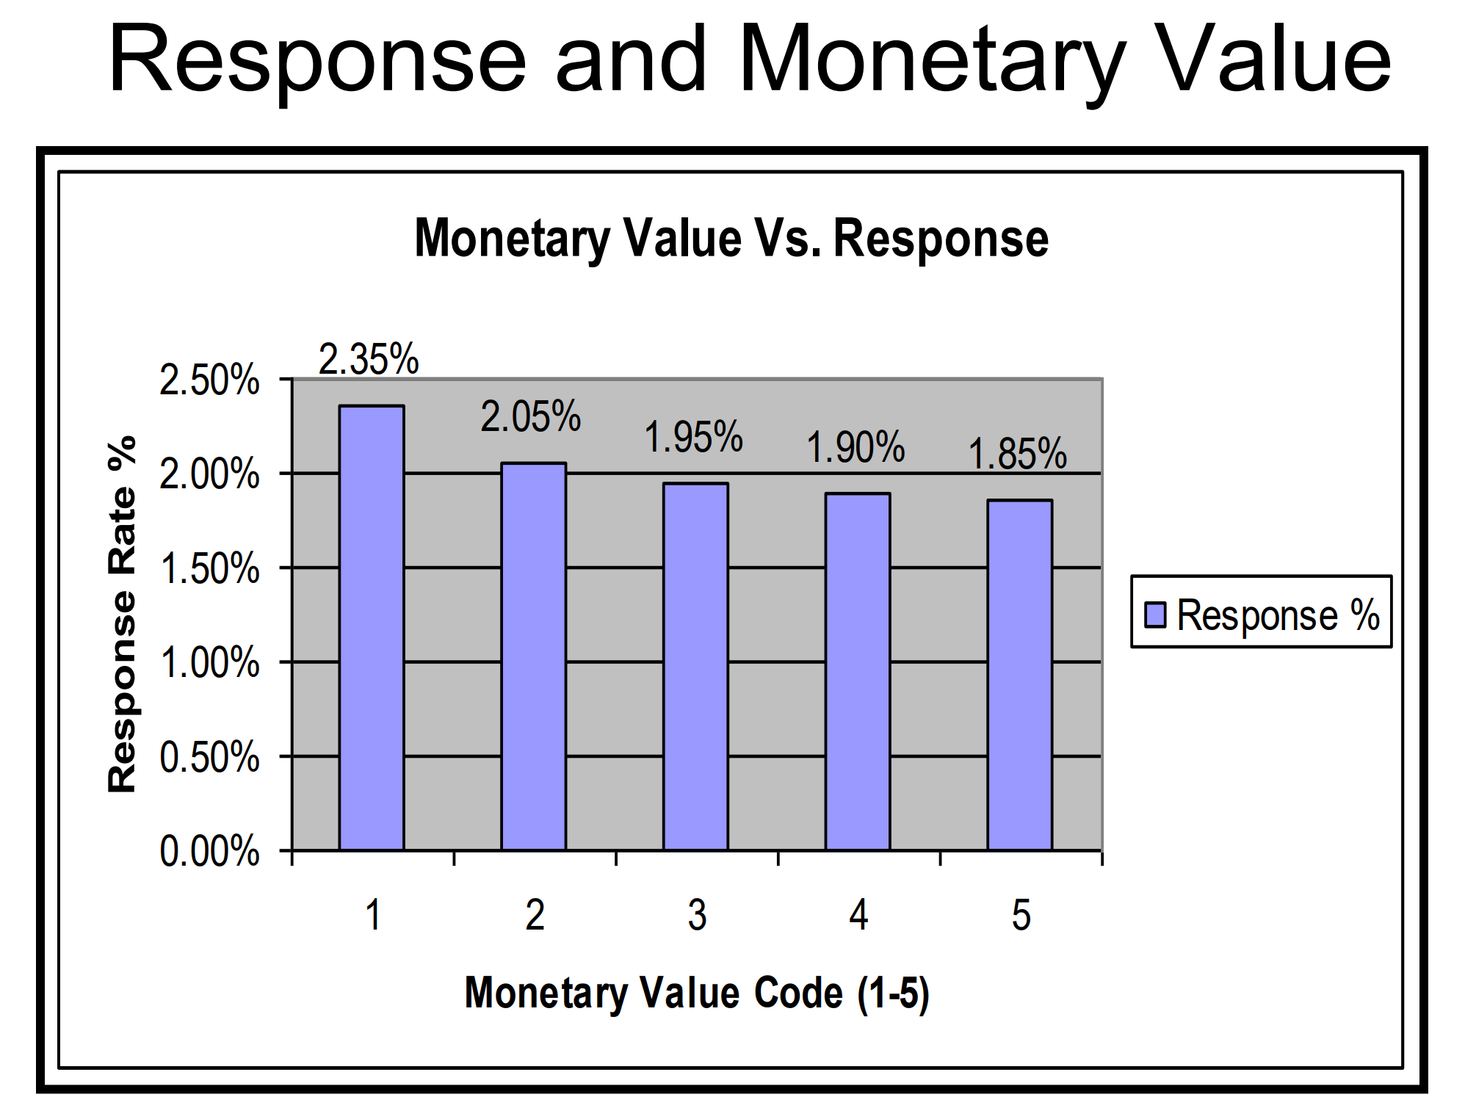
Customer data is sorted, grouped and coded with a 1 to 5 value The highest response rate (2.35%) for the campaign was from those customers in the test group who fell in the highest monetary value quintile (monetary value code =1).

Slide 13
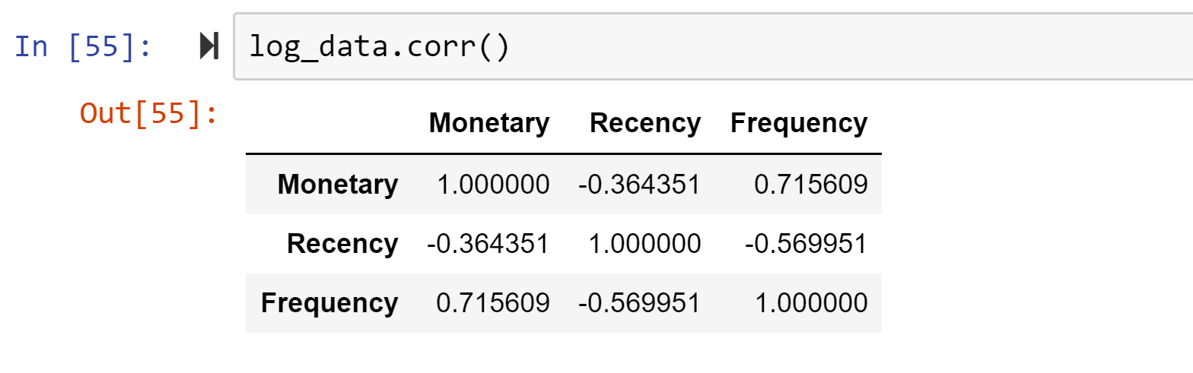
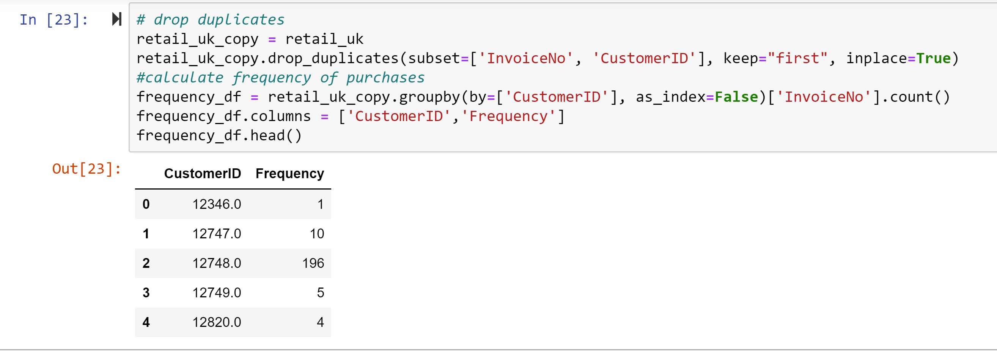
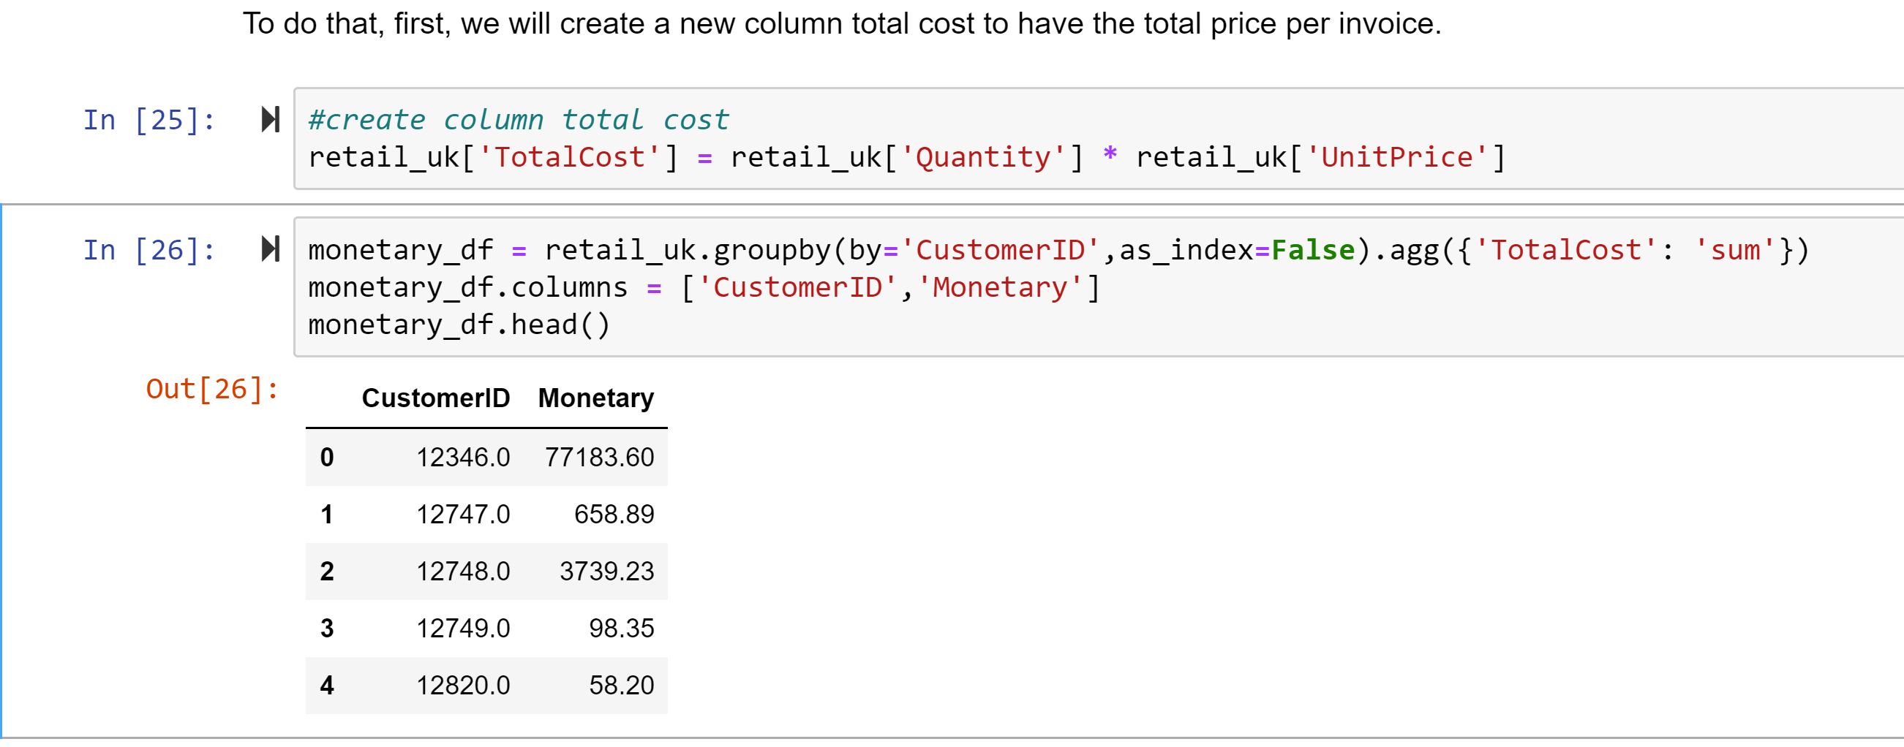
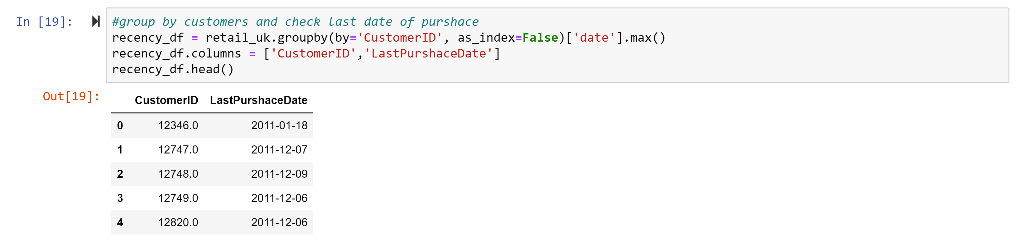
(RFM) …Code snapshot:

Slide 14
RFM MODEL BASED CLUSTERING ANALYSIS
Summary of the target dataset
Variable name | Minimum | Median | Maximum
Recency | 0 | 3.2 | 12
Frequency | 1 | 4.9 | 169
Monetary | 3.75 | 1586.63 | 88 125.38
First_Purchase | 0 | 7.5 | 12
Cluster | Population size | Percentage
1 | 527 | 14.14
2 | 636 | 17.07
3 | 1748 | 46.91
4 | 627 | 16.83
5 | 188 | 5.05
K means clustering method has been used here.

Slide 15
Statistics of each cluster
 | Minimum | Median | Maximum
Cluster 1
Recency | 8 | 9.8 | 12
Frequency | 1 | 1.3 | 4
Monetary | 3.75 | 361.2 | 7741.47
First_Purchase | 8 | 11.1 | 12
Cluster 2
Recency | 4 | 5.4 | 7
Frequency | 1 | 2.3 | 13
Monetary | 15 | 586.19 | 3906.27
First_Purchase | 4 | 7.7 | 12
Cluster 3
Recency | 0 | 1.5 | 3
Frequency | 1 | 2.6 | 7
Monetary | 20.8 | 685.71 | 4314.72
First_Purchase | 0 | 5.3 | 12
Cluster 4
Recency | 0 | 1 | 5
Frequency | 3 | 8.3 | 16
Monetary | 191.17 | 2425.09 | 7330.8
First_Purchase | 1 | 1 | 12
Cluster 5
Recency | 0 | 0.7 | 6
Frequency | 3 | 17.7 | 28
Monetary | 1641.48 | 5962.85 | 13 110.02
First_Purchase | 0 | 11.1 | 12
Cluster 1 relates to some 527 consumers, composed of 14.4 per cent of the whole population. This group seems to be the least profitable group as none of the customers in this group purchased anything in the second half of the year. Even for the first half of the year, the consumers didn’t shop often, and the average value of frequency was only 1.3.
There are some 459 consumers in cluster 2. This group of customers has a lower frequency throughout the year and a significantly smaller average value of monetary, indicating that a much smaller amount of spending per consumer. This group can be categorized as medium monetary with a medium spending per consumer.
Cluster 3 is the largest-sized group with 1748 consumers. Consumers in this group have a reasonable value of frequency. The group includes many newly registered consumers starting shopping with the retailer very recently. This group seems to have represented ordinary consumers and therefore has a certain level of uncertainty in terms of profitability.
Cluster 4 contains some 627 consumers with a very high value for frequency and monetary. This group seems to be the second high profit group.
The 188 customers in cluster 5 mainly started shopping with the online retailer at the beginning of the year, and continued to the end of the year with an average value of recency 0.7. They purchased quite often and as a result, spent a quite high amount of money. This group of consumers can be categorized as very high recency, very high frequency and very high monetary with a high spending per consumer. This group, although the smallest (only composed of 5.05 per cent of the whole population), seems to be the most profitable group.

Slide 16
Customer segmentation by cluster
Cluster | Population size | Percentage | Result
1 | 527 | 14.14 | Low profit
2 | 636 | 17.07 | Medium to high profit
3 | 1748 | 46.91 | Ordinary profit
4 | 627 | 16.83 | Second highest profit
5 | 188 | 5.05 | High Profit
22 per cent of the consumers contributed roughly 60 per cent of the total sales

Slide 17
Considering the below aspects can change the outcome of the model:
exploring the associations among consumer groups and the products they have purchased
Examining
which specific times (seasons), what products and which types of products they have purchased frequently will be beneficiary to the business.
Conducting
association analysis to establish customer buying patterns with regard to which products have been purchased together frequently by which customers and which customer groups
Exploring

Slide 18
Thank You

